Slide 1
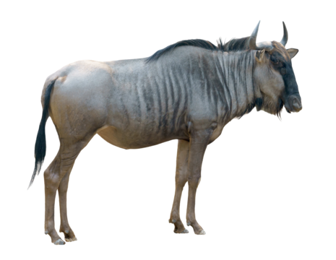
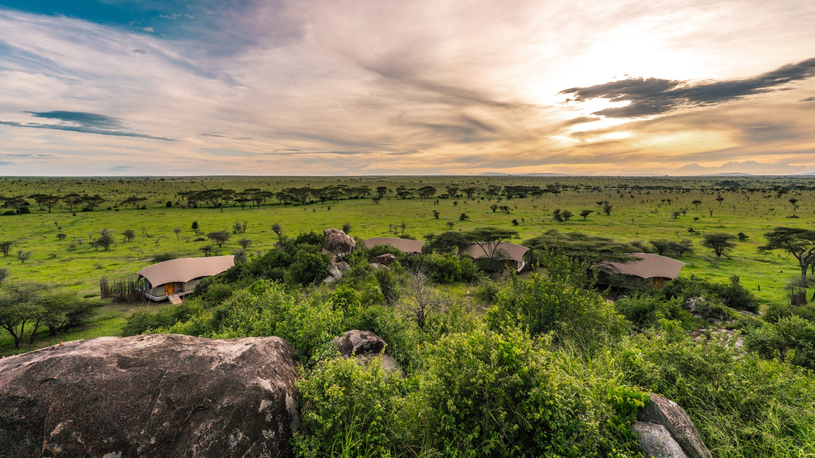
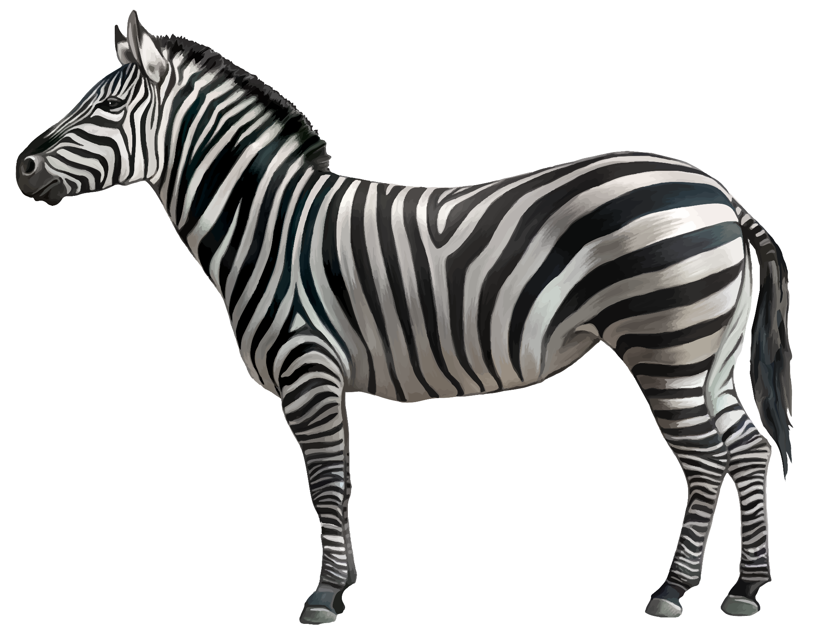
Web-scraping the Serengeti
To assist with remote sensing SAR animal-tracking research
November 3, 2025

Slide 2
Contents
1.
Meet the team
2.
Problem / Research
3.
Our solution
4.
Automation of the task
5.
Human involvement
6.
Reproducibility
7.
Validation
8.
Timeline
9.
Questions

Slide 3



Meet the team
William Stanziano
President
Chris Tillotson
CEO
Chris Jr.
Intern
William was born in the Serengeti. He grew up riding zebras, hunting wildebeests, and scaring away poachers with mimic-elephant bellows.
Chris knows all coding languages and ALL math.
Chris Jr. doesn’t come to class very much. That’s why you haven’t seen him before.

Slide 4
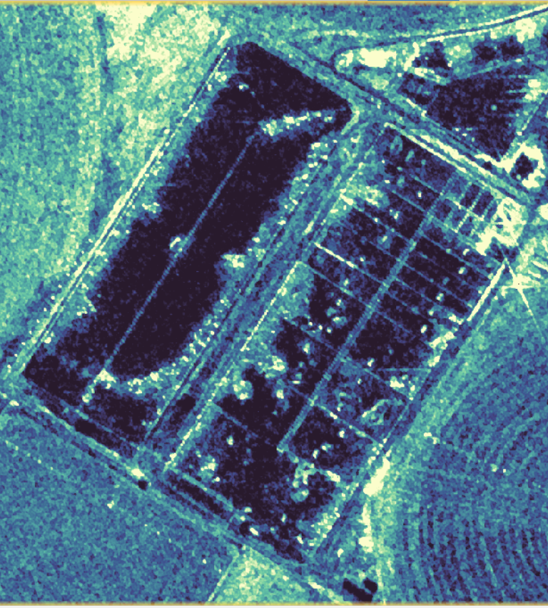
Detection of large mammals in the Serengeti
Remote sensing
Short-Aperture Radar (SAR)
penetrates clouds
Remotely sensed large animals: wild horse / burro containment in Utah
Need for ground truth

Slide 5
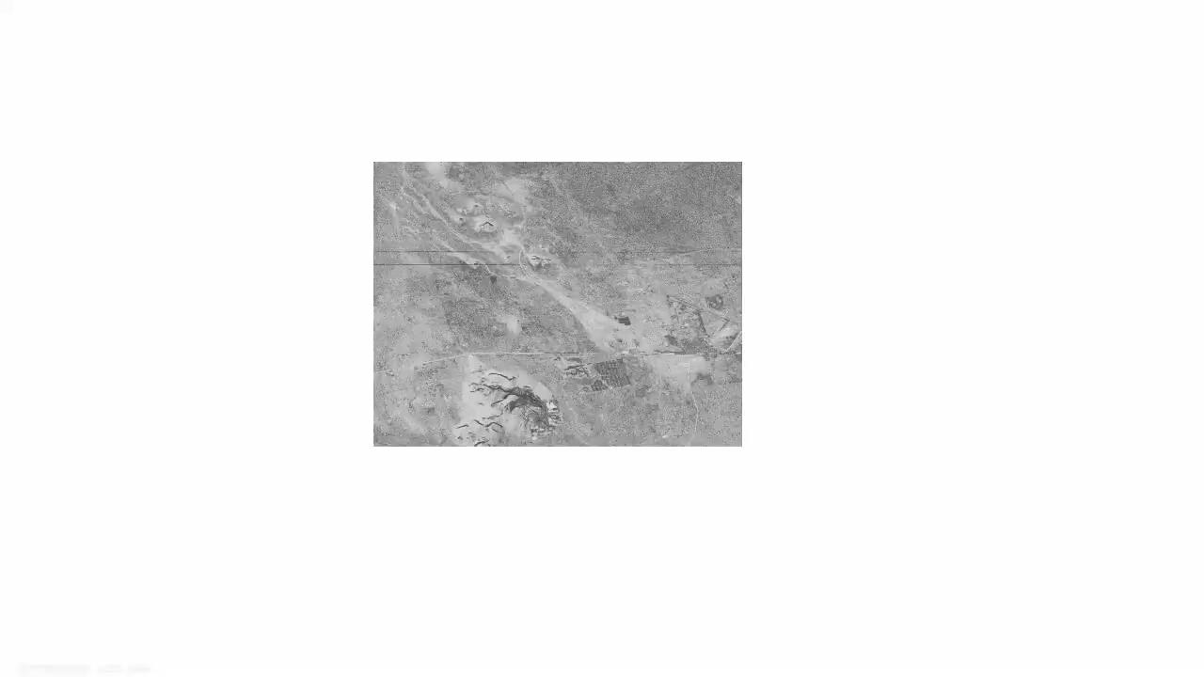

Slide 6
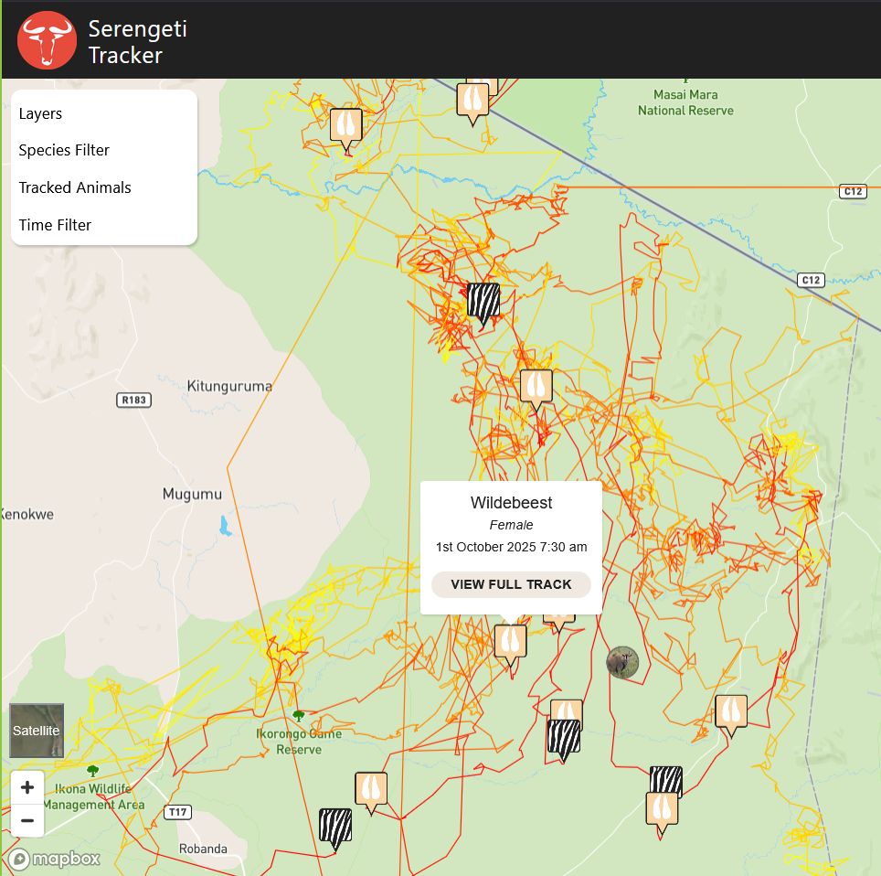
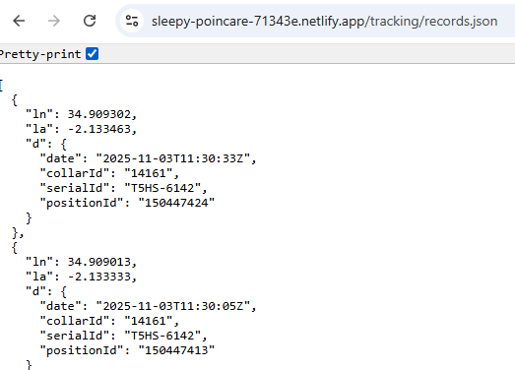
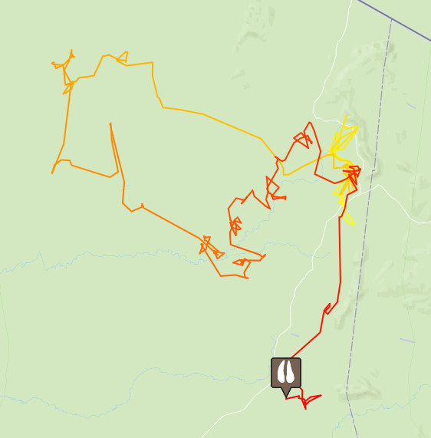
Our Solution (Goals)
Data
Specific animal positions, timestamps
Species associated with IDs
Queries
Query latest data
Last date: YYYY-MM-DD HH:MM:SS
Recommended: (1x month)
Species
Wildebeest
Zebra
Specific ID:
(Enter)
Export options
Location
(Select on Map)
(Enter)
CSV
Shapefile
GeoJson
PNG
Time
(Select on Calendar)
(Enter)

Slide 7
Key point:
Automation
How our project addresses this
Source dataset periodically updates, so will ours
Eliminate problem of data disappearing
Formatting of data into usable formats

Slide 8
Key point:
Human
Involvement
How our project addresses this
ALL operations through launched dashboard buttons:
(although suggested for primary researcher to also regularly push to GitHub)
Scrape latest data
Queries
Visualization
Formatting

Slide 9
Key point:
Reproducibility
How our project addresses this
Launchable Dashboard
Updating database to be accessed (push on GitHub) by trusted users

Slide 10
Key point:
Validation
How our project addresses this
Verifying beginning to end of pipeline all within the dashboard
Test on different machines
Formats are usable in GIS software
Handle:
Addition of new species
Addition of new animals (collars)
Failsafes:
Website is down or html-formatting changes
Warning displayed on dashboard so trusted users can update code
Database fails to be updated in 3-month window
Creating of clearly “dummy” data to ensure tools function, but that analysis by researchers is well-informed

Slide 11
Project roadmap
Deliverable
Link to public repo
Downloadable, deployable dashboard
Week 5
Documentation
Dashboard options expansion
Week 4 (Thanksgiving)
Testing
Minor UI adjustments
Week 3
Skeleton Dashboard
Dash by Plotly (local)
Week 2
Database
Week 1 (This week)
Web Scraping
Positions
Associated species

Slide 12
Questions
November 3, 2025

